Slide 1
MATH 685/ CSI 700/ OR 682
Lecture Notes
Lecture 6.
Eigenvalue problems.
Notes:
Math 685/CSI 700 Spring 08
George Mason University, Department of Mathematical Sciences

Slide 2
Eigenvalue problems
Eigenvalue problems occur in many areas of science and engineering, such as structural analysis
Eigenvalues are also important in analyzing numerical
methods
Theory and algorithms apply to complex matrices as well
as real matrices
With complex matrices, we use conjugate transpose, A^{H}, instead of usual transpose, A^{T}
Notes:
Math 685/CSI 700 Spring 08
George Mason University, Department of Mathematical Sciences

Slide 3
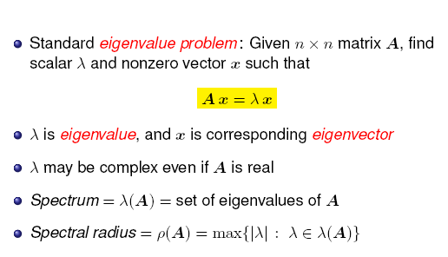
Formulation
Matrix expands or shrinks any vector lying in direction of eigenvector by scalar factor
Expansion or contraction factor is given by corresponding eigenvalue
Eigenvalues and eigenvectors decompose complicated behavior of general linear transformation into simpler actions
Notes:
Math 685/CSI 700 Spring 08
George Mason University, Department of Mathematical Sciences

Slide 4
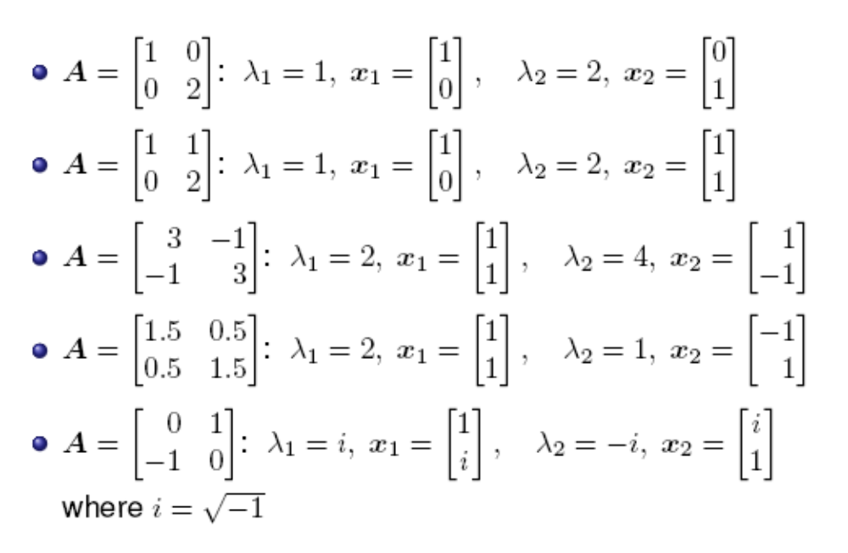
Examples
Notes:
Math 685/CSI 700 Spring 08
George Mason University, Department of Mathematical Sciences

Slide 5
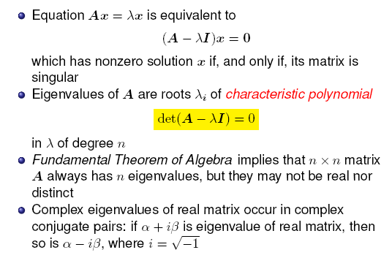
Characteristic polynomial
Notes:
Math 685/CSI 700 Spring 08
George Mason University, Department of Mathematical Sciences

Slide 6
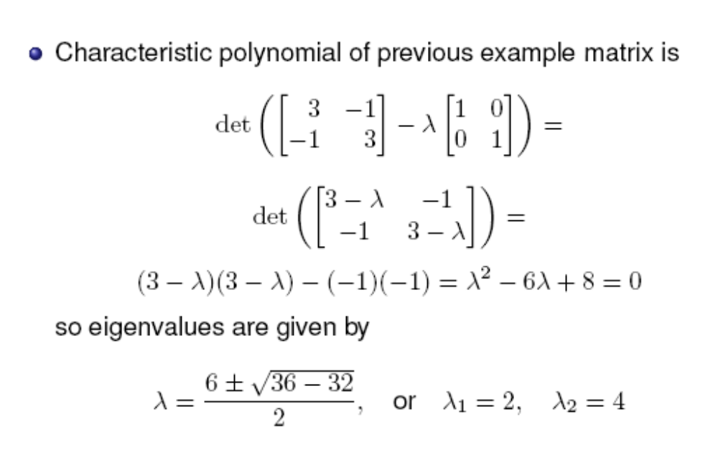
Example
Notes:
Math 685/CSI 700 Spring 08
George Mason University, Department of Mathematical Sciences

Slide 7
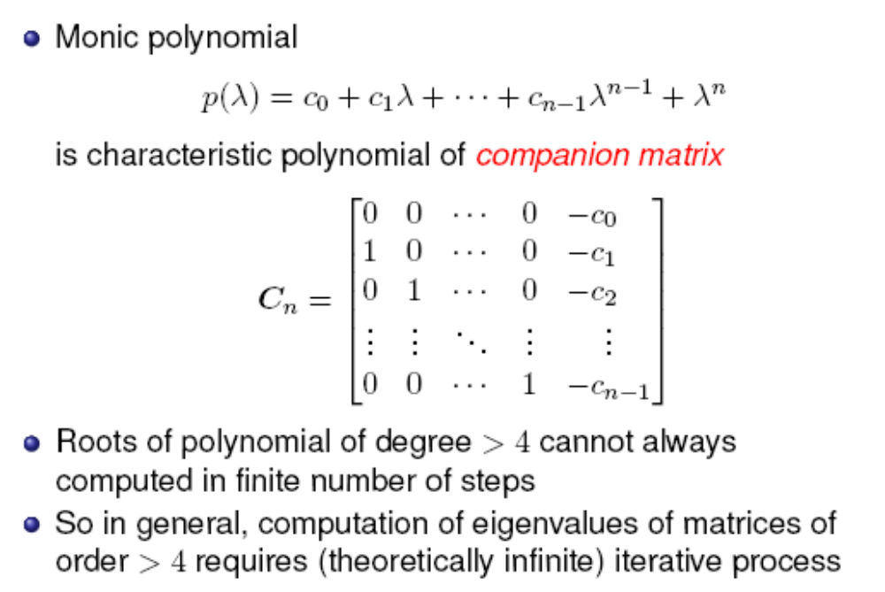
Companion matrix
Notes:
Math 685/CSI 700 Spring 08
George Mason University, Department of Mathematical Sciences

Slide 8
Characteristic polynomial
Computing eigenvalues using characteristic polynomial is not recommended because of
  work in computing coefficients of characteristic polynomial
  sensitivity of coefficients of characteristic polynomial
  work in solving for roots of characteristic polynomial
Characteristic polynomial is powerful theoretical tool but usually not useful computationally
Notes:
Math 685/CSI 700 Spring 08
George Mason University, Department of Mathematical Sciences

Slide 9
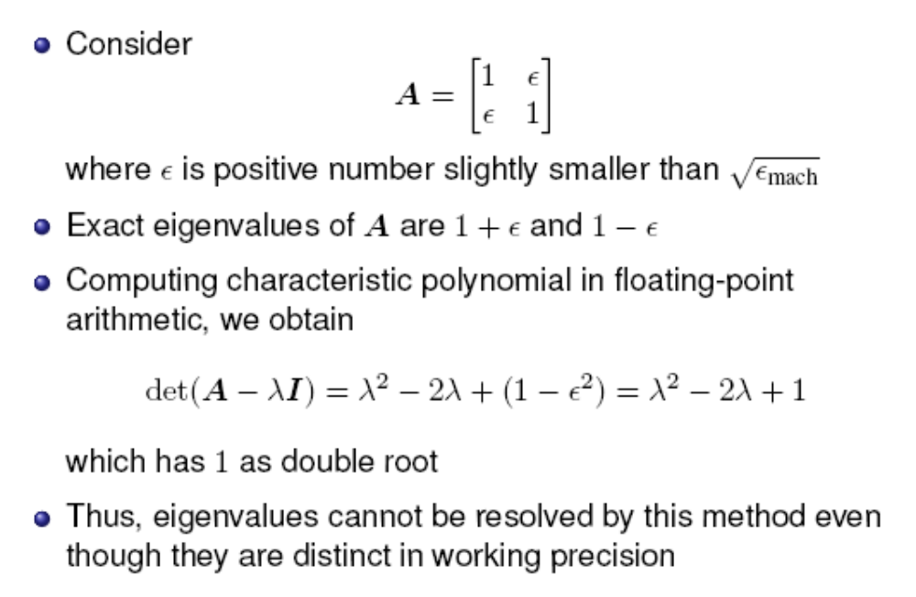
Example
Notes:
Math 685/CSI 700 Spring 08
George Mason University, Department of Mathematical Sciences

Slide 10
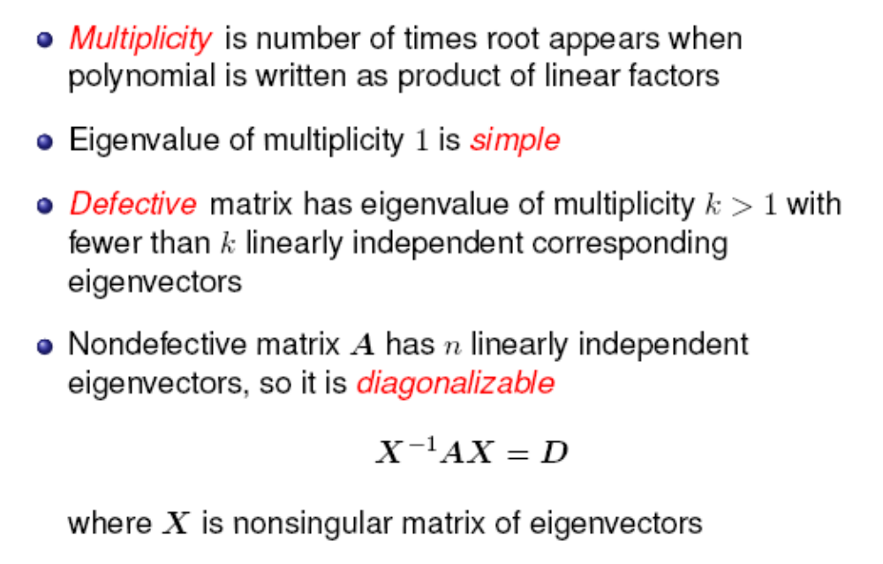
Diagonalizability
Notes:
Math 685/CSI 700 Spring 08
George Mason University, Department of Mathematical Sciences

Slide 11
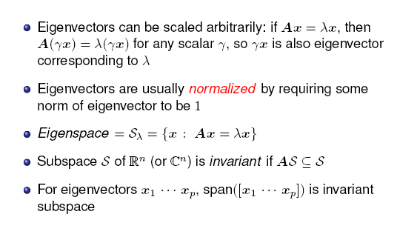
Eigenspaces
Notes:
Math 685/CSI 700 Spring 08
George Mason University, Department of Mathematical Sciences

Slide 12
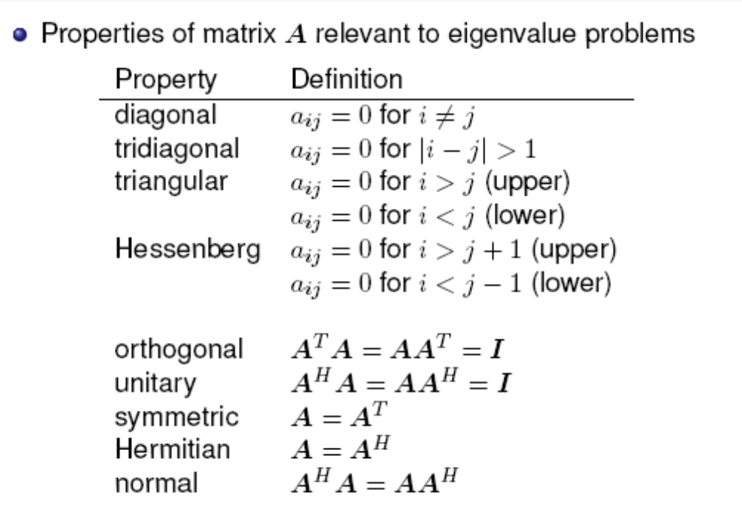
Some relevant definitions
Notes:
Math 685/CSI 700 Spring 08
George Mason University, Department of Mathematical Sciences

Slide 13
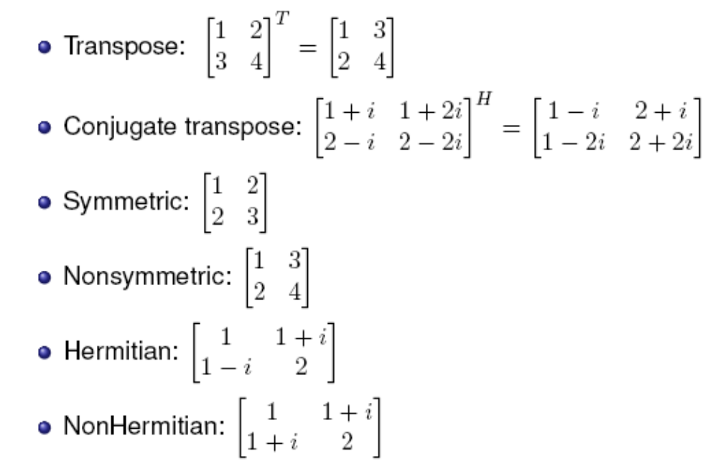
Examples
Notes:
Math 685/CSI 700 Spring 08
George Mason University, Department of Mathematical Sciences

Slide 14
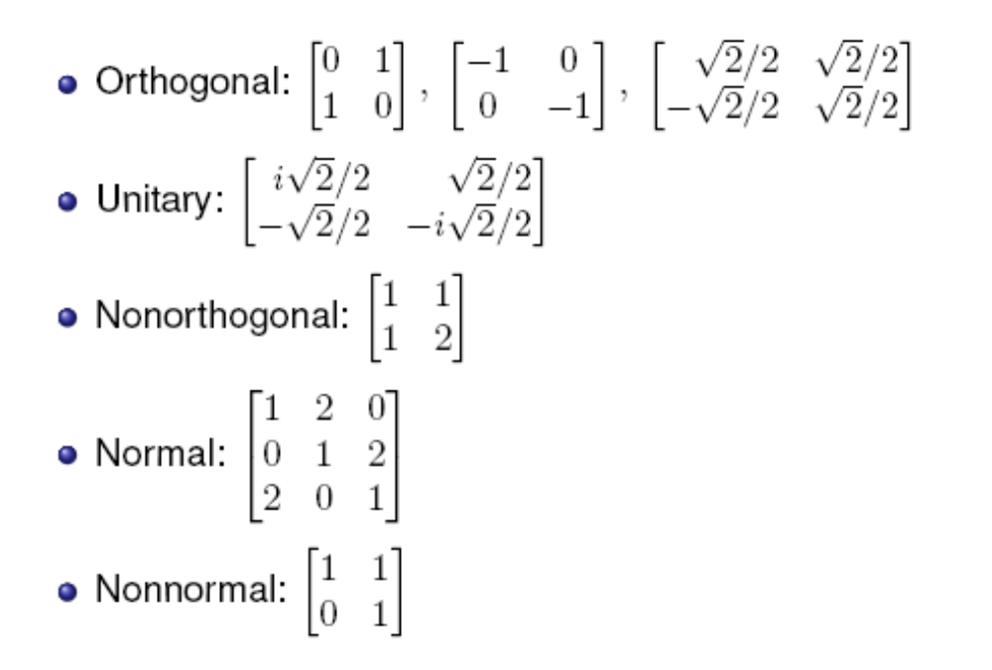
Examples
Notes:
Math 685/CSI 700 Spring 08
George Mason University, Department of Mathematical Sciences

Slide 15
Properties of eigenvalue problems
Properties of eigenvalue problem affecting choice of algorithm and software
  Are all eigenvalues needed, or only a few?
  Are only eigenvalues needed, or are corresponding eigenvectors also needed?
  Is matrix real or complex?
  Is matrix relatively small and dense, or large and sparse?
  Does matrix have any special properties, such as symmetry, or is it general matrix?
Condition of eigenvalue problem is sensitivity of eigenvalues and eigenvectors to changes in matrix
Conditioning of eigenvalue problem is not same as conditioning of solution to linear system for same matrix
Different eigenvalues and eigenvectors are not necessarily equally sensitive to perturbations in matrix
Notes:
Math 685/CSI 700 Spring 08
George Mason University, Department of Mathematical Sciences

Slide 16
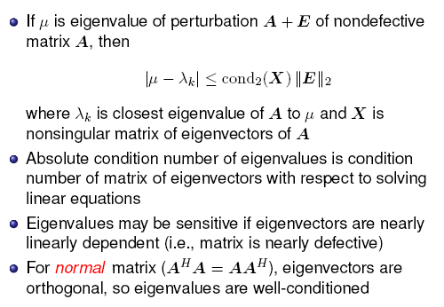
Conditioning of eigenvalues
Notes:
Math 685/CSI 700 Spring 08
George Mason University, Department of Mathematical Sciences

Slide 17
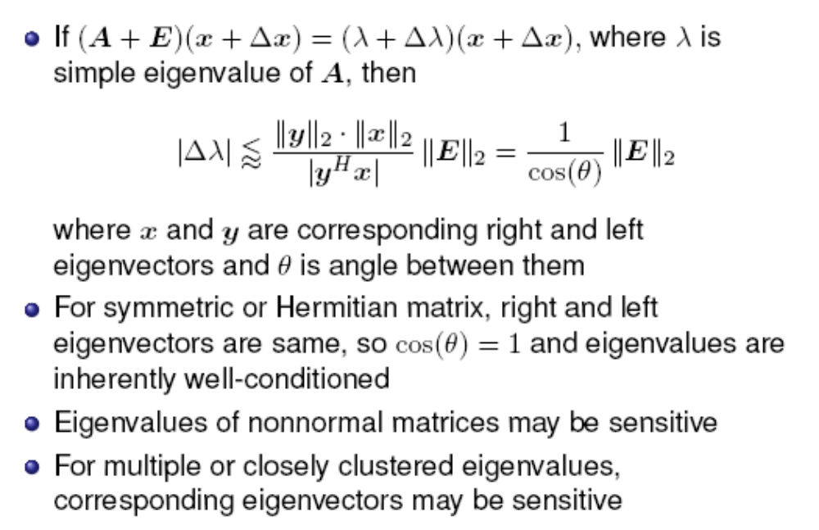
Conditioning of eigenvalues
Notes:
Math 685/CSI 700 Spring 08
George Mason University, Department of Mathematical Sciences

